Slide 1

Lecture Presentation
Chapter 20 Electrochemistry
James F. Kirby
Quinnipiac University
Hamden, CT

Slide 2
Electrochemistry
Electrochemistry is the study of the relationships between electricity and chemical reactions. It includes the study of both spontaneous and nonspontaneous processes.

Slide 3
Synopsis of Assigning Oxidation Numbers (as a Reminder)
Elements = 0
Monatomic ion = charge
F: –1
O: –2 (unless peroxide = –1)
H: +1 (unless a metal hydride = –1)
The sum of the oxidation numbers equals the overall charge (0 in a compound).

Slide 4
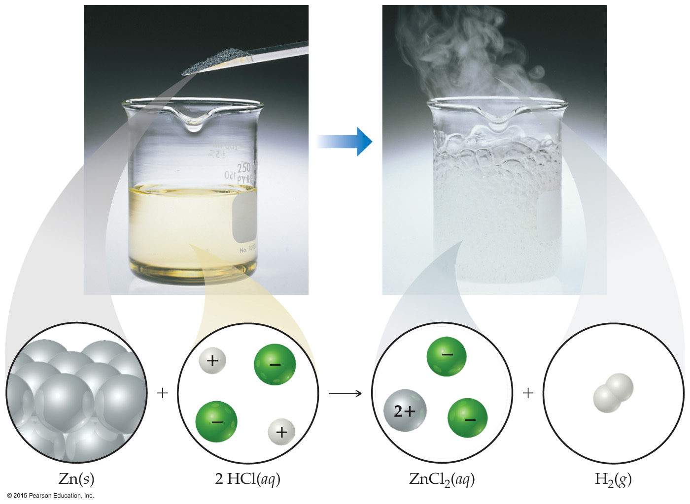
Oxidation Numbers
To keep track of what loses electrons and what gains them, we assign oxidation numbers.
If the oxidation number increases for an element, that element is oxidized.
If the oxidation number decreases for an element, that element is reduced.

Slide 5
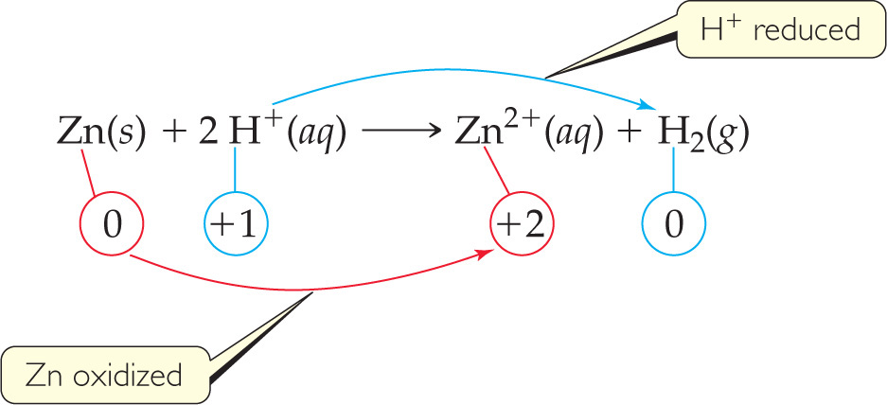
Oxidation and Reduction
A species is oxidized when it loses electrons.
Zinc loses two electrons, forming the Zn²⁺ ion.
A species is reduced when it gains electrons.
H⁺ gains an electron, forming H₂.
An oxidizing agent causes something else to be oxidized (H⁺); a reducing agent causes something else to be reduced (Zn).

Slide 6
Half-Reactions
The oxidation and reduction are written and balanced separately.
We will use them to balance a redox reaction.
For example, when Sn²⁺ and Fe³⁺ react,

Slide 7
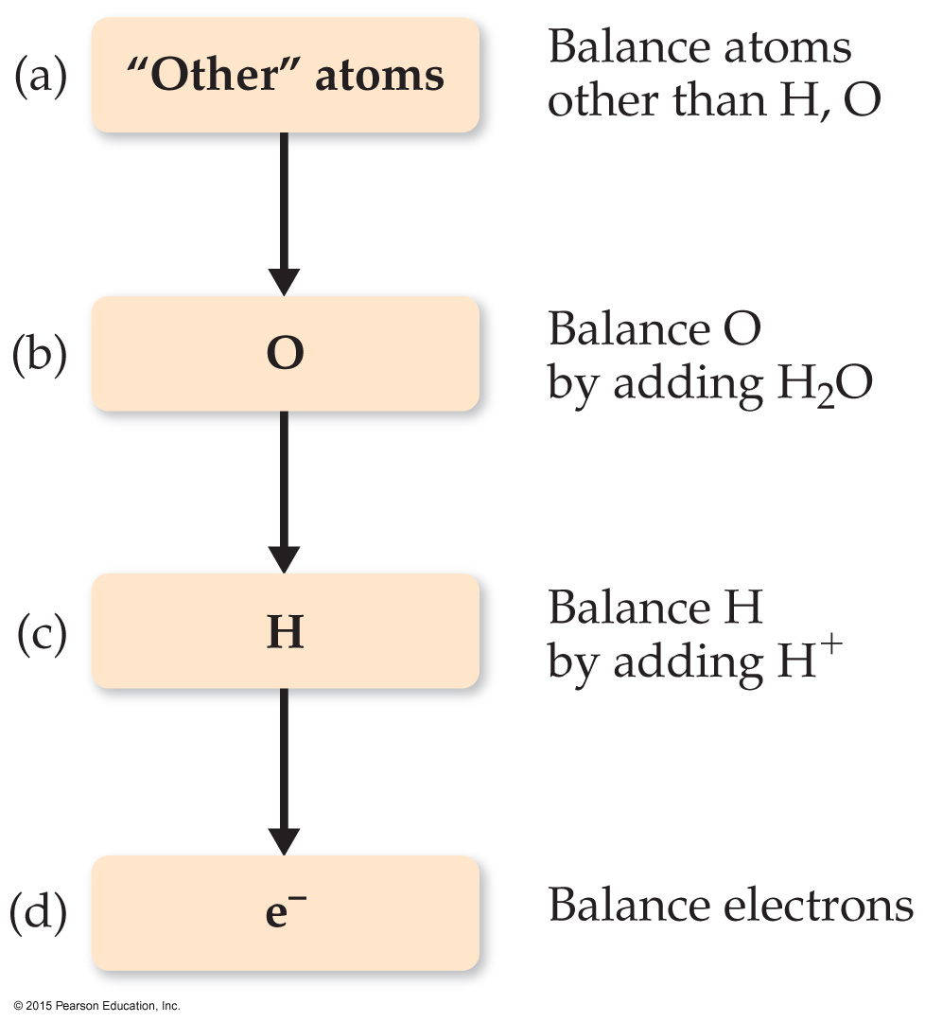
Balancing Redox Equations: The Half-Reactions Method (a Synopsis)
Make two half-reactions (oxidation and reduction).
Balance atoms other than O and H. Then, balance O and H using H₂O/H⁺.
Add electrons to balance charges.
Multiply by common factor to make electrons in half- reactions equal.
Add the half-reactions.
Simplify by dividing by common factor or converting H⁺ to OH– if basic.
Double-check atoms and charges balance!

Slide 8
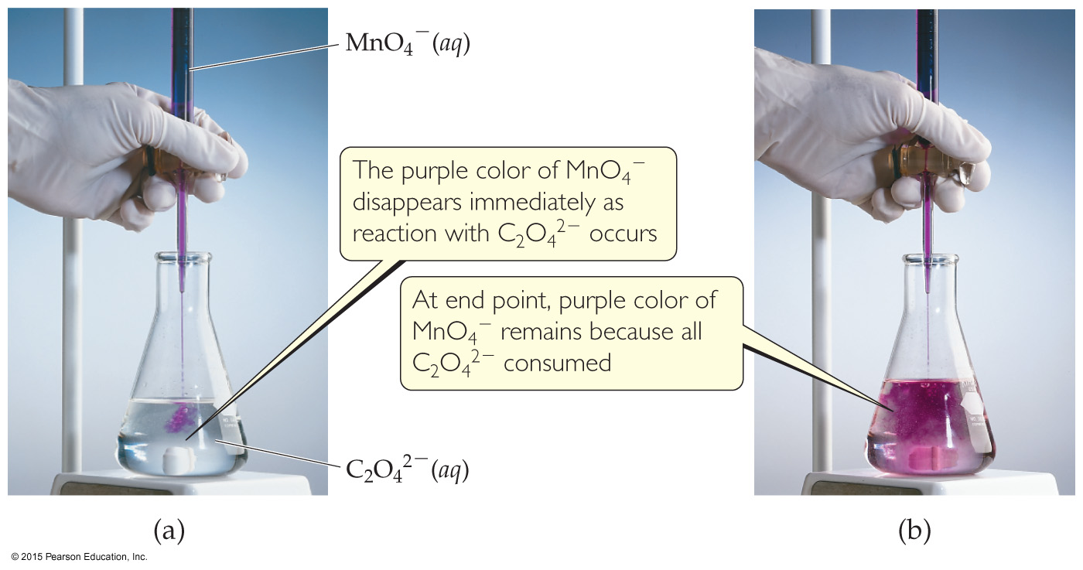
The Half-Reaction Method
Consider the reaction between MnO₄– and C₂O₄^{2–}:
MnO₄–(aq) + C₂O₄^{2–}(aq) ⎯⎯→ Mn²⁺(aq) + CO₂(aq)
Assigning oxidation numbers shows that Mn is reduced (+7 → +2) and C is oxidized (+3 → +4).

Slide 9
Oxidation Half-Reaction
C₂O₄^{2–} ⎯⎯→ CO₂
To balance the carbon, we add a coefficient of 2:
C₂O₄^{2–} ⎯⎯→ 2 CO₂

Slide 10
Oxidation Half-Reaction
C₂O₄^{2–} ⎯⎯→ 2 CO₂
The oxygen is now balanced as well. To balance the charge, we must add two electrons to the right side:
C₂O₄^{2–} ⎯⎯→ 2 CO₂ + 2e–

Slide 11
Reduction Half-Reaction
MnO₄– ⎯⎯→ Mn²⁺
The manganese is balanced; to balance the oxygen, we must add four waters to the right side:
MnO₄– ⎯⎯→ Mn²⁺ + 4 H₂O

Slide 12
Reduction Half-Reaction
MnO₄– ⎯⎯→ Mn²⁺ + 4 H₂O
To balance the hydrogen, we add 8H⁺ to the left side:
8 H⁺ + MnO₄– ⎯⎯→ Mn²⁺ + 4 H₂O

Slide 13
Reduction Half-Reaction
8 H⁺ + MnO₄– ⎯⎯→ Mn²⁺ + 4 H₂O
To balance the charge, we add 5e– to the left side:
5e– + 8 H⁺ + MnO₄– ⎯⎯→ Mn²⁺ + 4 H₂O

Slide 14
Combining the Half-Reactions
Now we combine the two half-reactions together:
C₂O₄^{2–} ⎯⎯→ 2 CO₂ + 2e–
5e– + 8 H⁺ + MnO₄– ⎯⎯→ Mn²⁺ + 4 H₂O
To make the number of electrons equal on each side, we will multiply the first reaction by 5 and the second by 2:

Slide 15
Combining the Half-Reactions
5 C₂O₄^{2–} ⎯⎯→ 10 CO₂ + 10e–
10e– + 16 H⁺ + 2 MnO₄– ⎯⎯→ 2 Mn²⁺ + 8 H₂O
When we add these together, we get
10e– + 16 H⁺ + 2 MnO₄– + 5 C₂O₄^{2–} ⎯⎯→
2 Mn²⁺ + 8 H₂O + 10 CO₂ +10e–

Slide 16
Combining the Half-Reactions
10e– + 16H⁺ + 2 MnO₄– + 5 C₂O₄^{2–} ⎯⎯→
2 Mn²⁺ + 8 H₂O + 10 CO₂ +10e–
The only thing that appears on both sides is the electrons. Subtracting them, we are left with
16 H⁺ + 2 MnO₄– + 5 C₂O₄^{2–} ⎯⎯→
2 Mn²⁺ + 8 H₂O + 10 CO₂
(Verify that the equation is balanced by counting atoms and charges on each side of the equation.)

Slide 17
Balancing in Basic Solution
A reaction that occurs in basic solution can be balanced as if it occurred in acid.
Once the equation is balanced, add OH– to each side to “neutralize” the H⁺ in the equation and create water in its place.
If this produces water on both sides, subtract water from each side so it appears on only one side of the equation.

Slide 18
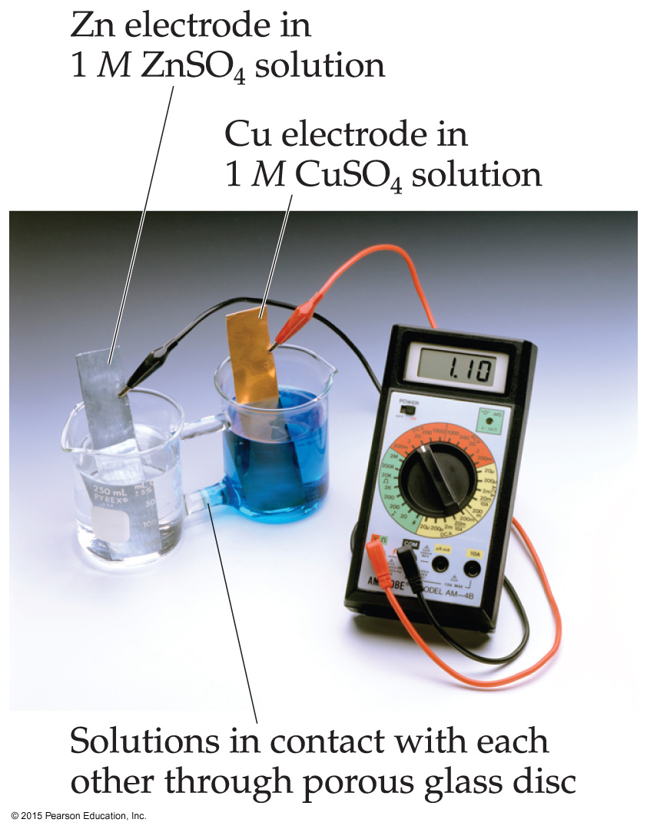
Voltaic Cells
In spontaneous redox reactions, electrons are transferred and energy is released.
That energy can do work if the electrons flow through an external device.
This is a voltaic cell.

Slide 19
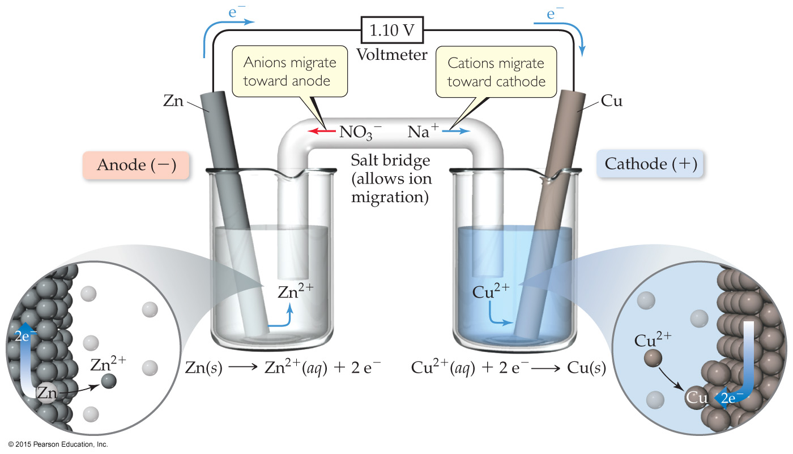
Voltaic Cells
The oxidation occurs at the anode.
The reduction occurs at the cathode.
When electrons flow, charges aren’t balanced. So, a salt bridge, usually a U-shaped tube that contains a salt/agar solution, is used to keep the charges balanced.

Slide 20
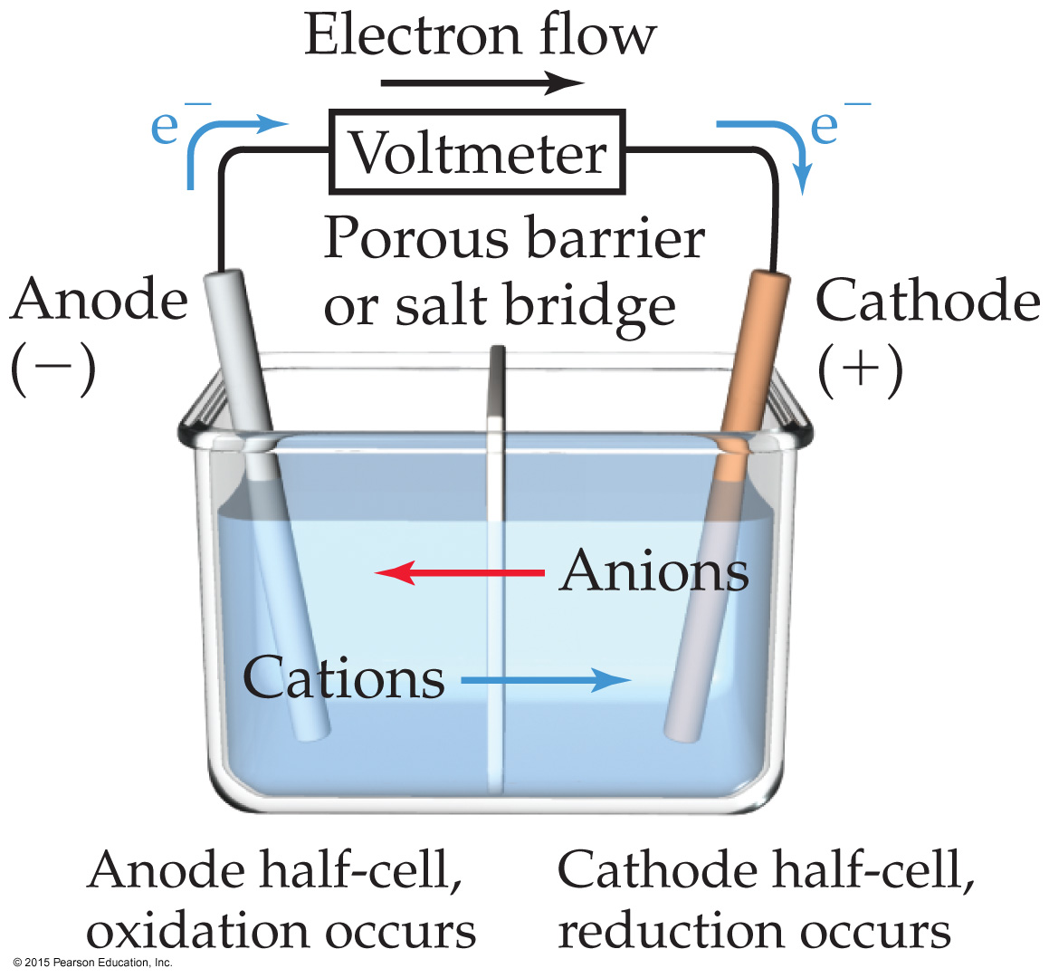
Voltaic Cells
In the cell, electrons leave the anode and flow through the wire to the cathode.
Cations are formed in the anode compartment.
As the electrons reach the cathode, cations in solution are attracted to the now negative cathode.
The cations gain electrons and are deposited as metal on the cathode.

Slide 21
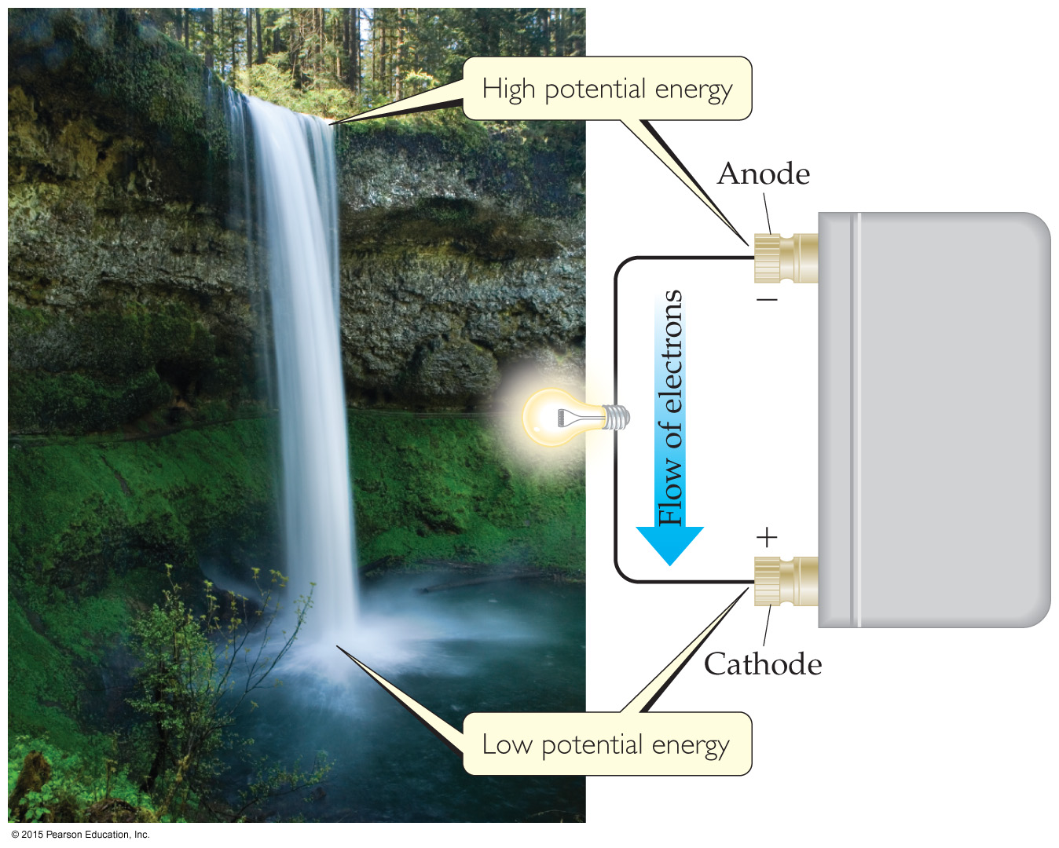
Electromotive Force (emf)
Water flows spontaneously one way in a waterfall.
Comparably, electrons flow spontaneously one way in a redox reaction, from high to low potential energy.

Slide 22
Electromotive Force (emf)
The potential difference between the anode and cathode in a cell is called the electromotive force (emf).
It is also called the cell potential and is designated E_{cell}.
It is measured in volts (V). One volt is one joule per coulomb (1 V = 1 J/C).

Slide 23
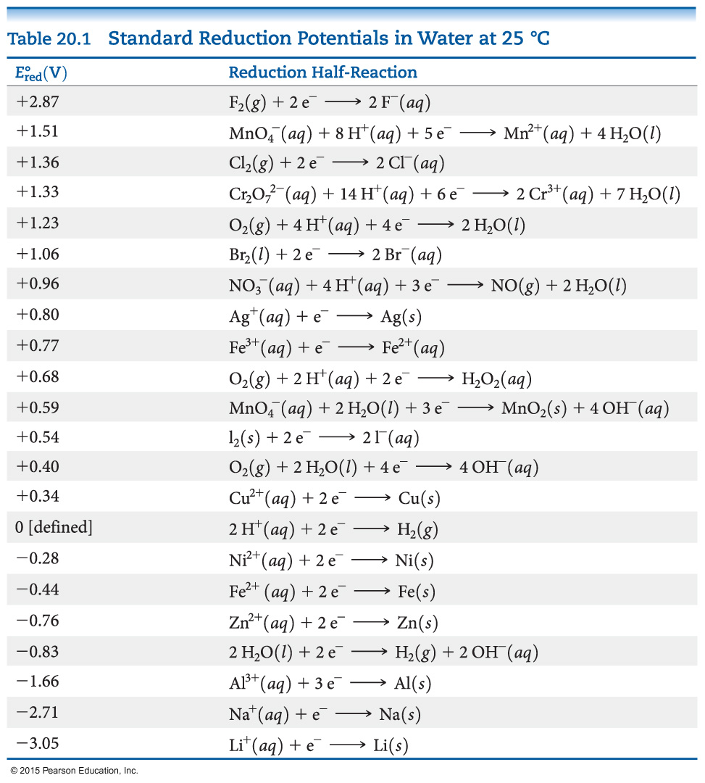
Standard Reduction Potentials
Reduction potentials for many electrodes have been measured and tabulated.
The values are compared to the reduction of hydrogen as a standard.

Slide 24
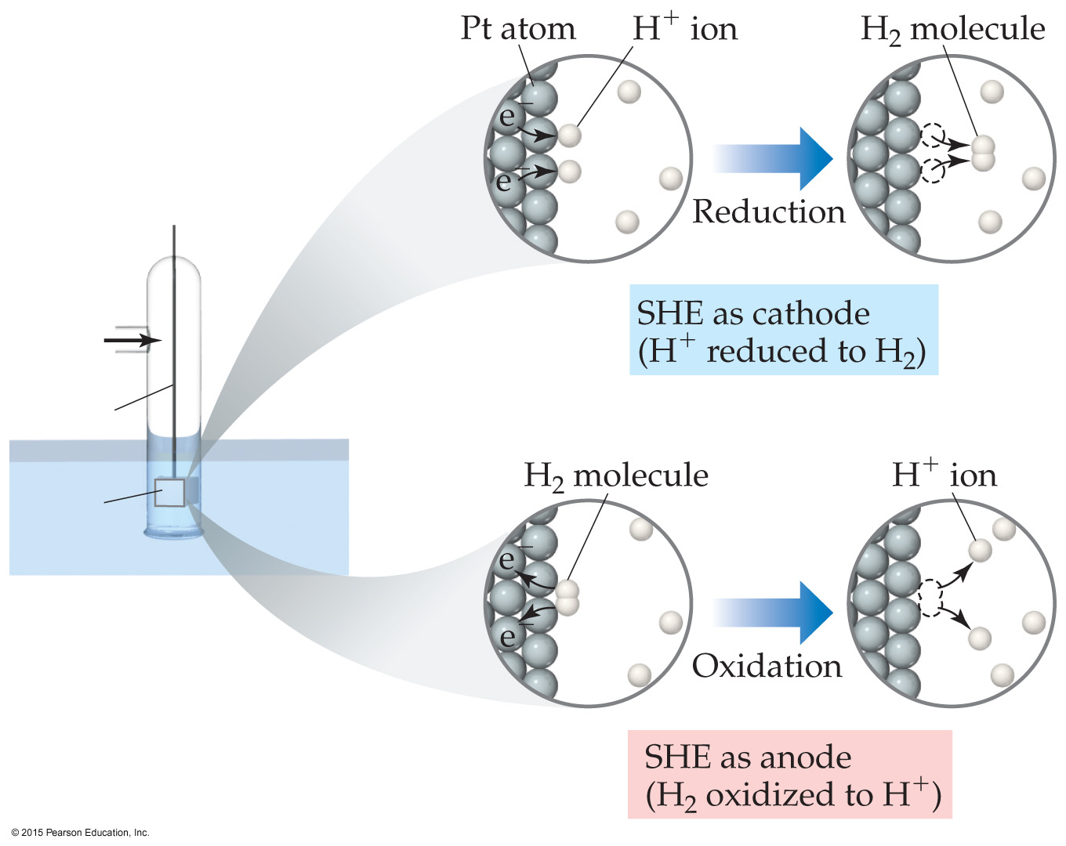
Standard Hydrogen Electrode
Their reference is called the standard hydrogen electrode (SHE).
By definition as the standard, the reduction potential for hydrogen is 0 V:
2 H⁺(aq, 1M) + 2e– ⎯→ H₂(g, 1 atm)

Slide 25
Standard Cell Potentials
The cell potential at standard conditions can be found through this equation:
°
°
°
E_{cell}
= E_{red} (cathode) – E_{red} (anode)
Because cell potential is based on the potential energy per unit of charge, it is an intensive property.

Slide 26
Cell Potentials
For the anode in this cell, E°_{red} = –0.76 V
For the cathode, E°_{red} = +0.34 V
So, for the cell, E°_{cell} = E°_{red} (cathode)–E°_{red} (anode)
= +0.34 V – (–0.76 V) = +1.10 V

Slide 27
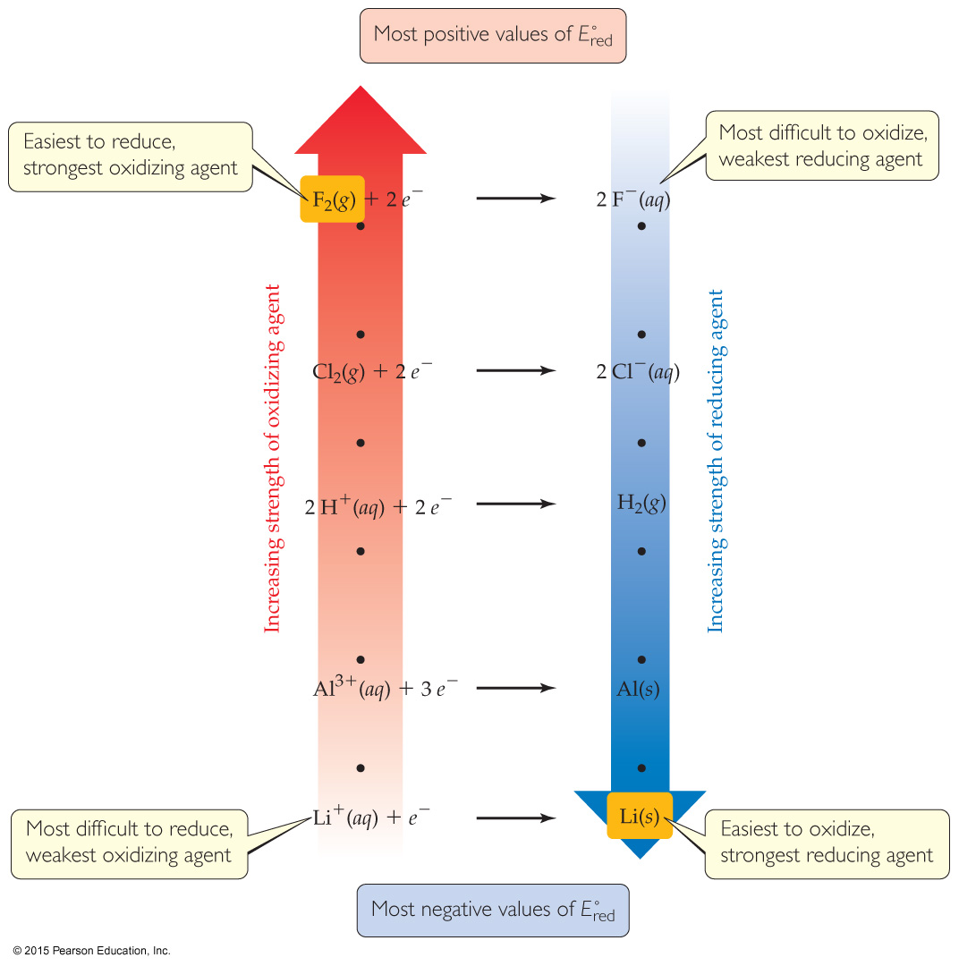
Oxidizing and Reducing Agents
The more positive the value of E°_{red}, the greater the tendency for reduction under standard conditions.
The strongest oxidizers have the most positive reduction potentials.
The strongest reducers have the most negative reduction potentials.

Slide 28
Free Energy and Redox
Spontaneous redox reactions produce a positive cell potential, or emf.
E° = E°_{red} (reduction/cathode) – E°_{red} (oxidation/anode)
Note that this is true for ALL redox reactions, not only for voltaic cells.
Since Gibbs free energy is the measure of spontaneity, positive emf corresponds to negative ΔG.
How do they relate? ΔG = –nFE (F is the Faraday constant, 96,485 C/mol.)

Slide 29
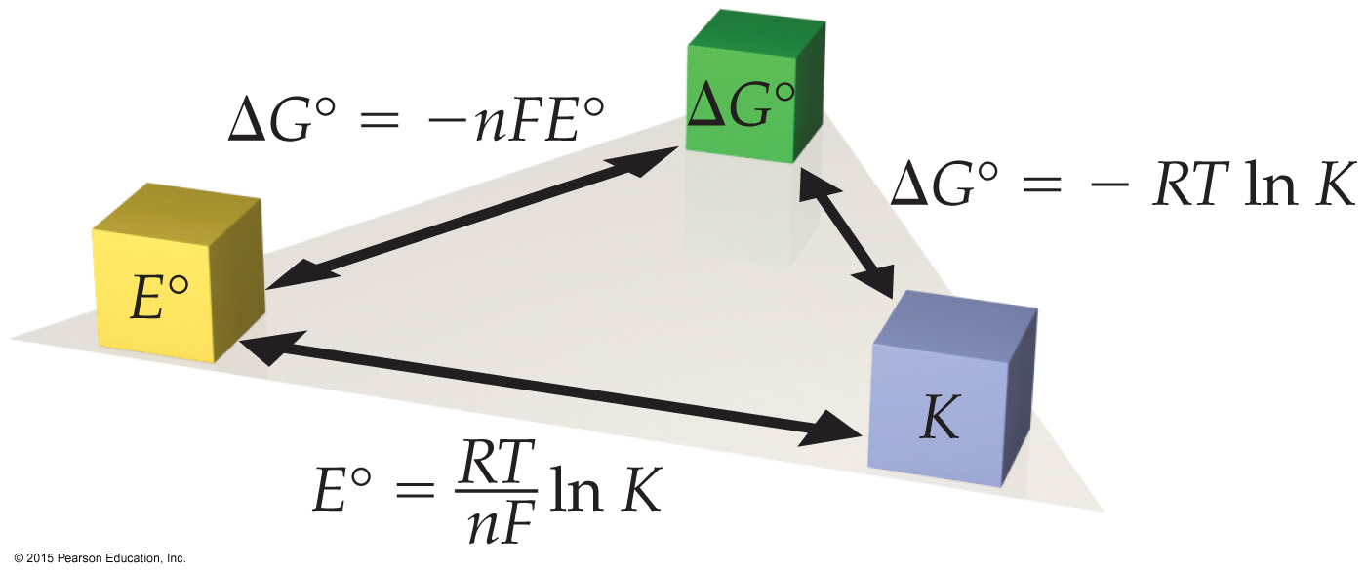
Free Energy, Redox, and K
How is everything related?
ΔG° = –nFE° = –RT ln K

Slide 30
Nernst Equation
Remember, ΔG = ΔG° + RT ln Q
So, –nFE = nFE° + RT ln Q
Dividing both sides by –nF, we get the Nernst equation:
E = E° – (RT/nF) ln Q
OR E = E° – (2.303 RT/nF) log Q
Using standard thermodynamic temperature （25+273.15） and the constants R and F,
E = E° – (0.0592/n) log Q

Slide 31
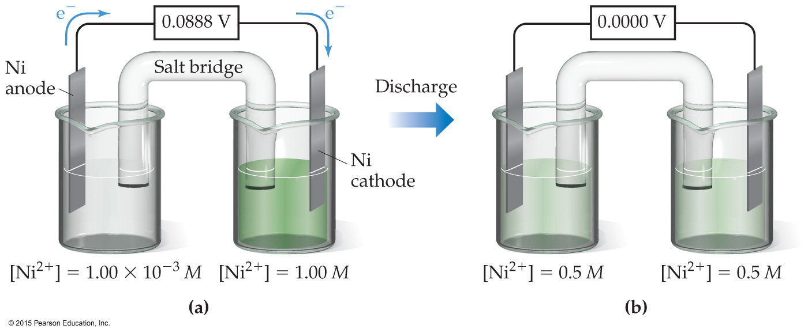
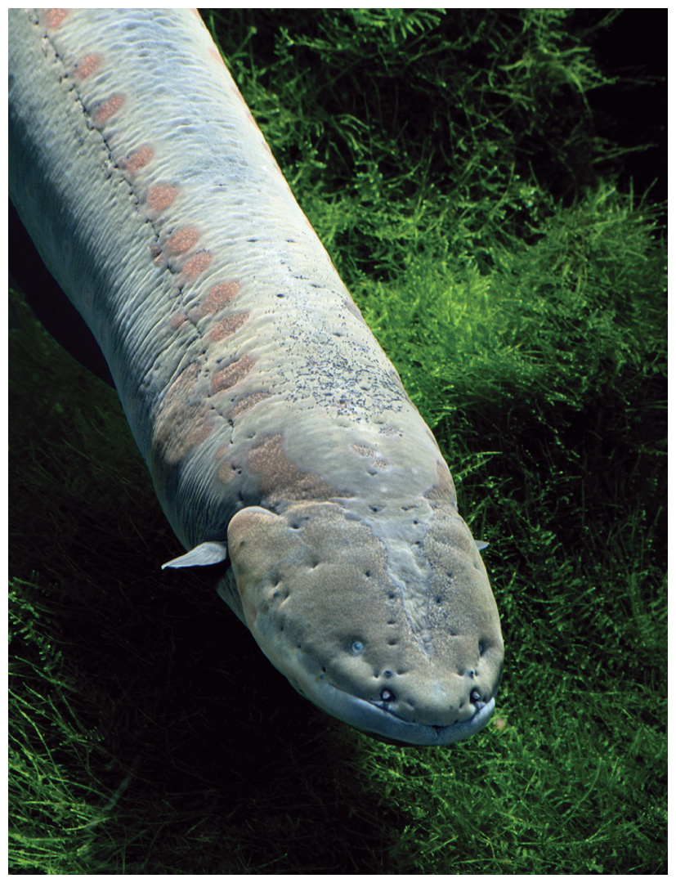
Concentration Cells
Notice that the Nernst equation implies that a cell could be created that has the same substance at both electrodes, called a concentration cell.
E_{cell}
For such a cell,
°
would be 0, but Q would not.
Therefore, as long as the concentrations are different, E will not be 0.

Slide 32
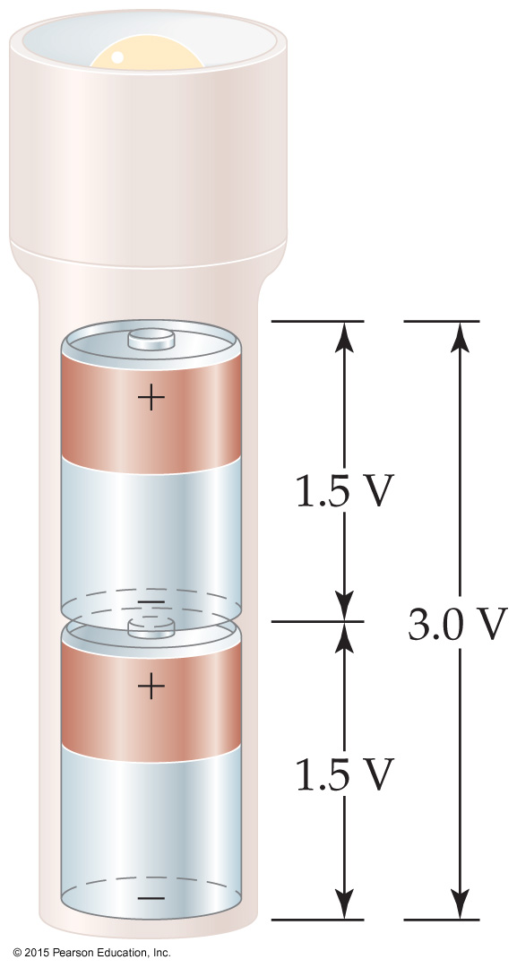
Some Applications of Cells
Electrochemistry can be applied as follows:
Batteries: a portable, self-contained electrochemical power source that consists of one or more voltaic cells.
Batteries can be primary cells (cannot be recharged when “dead”—the reaction is complete) or secondary cells (can be recharged).
Prevention of corrosion (“rust-proofing”)
Electrolysis

Slide 33
Some Examples of Batteries
Lead–acid battery: reactants and products are solids, so Q is 1 and the potential is independent of concentrations; however, made with lead and sulfuric acid (hazards).
Alkaline battery: most common primary battery.
Ni–Cd and Ni–metal hydride batteries: lightweight, rechargeable; Cd is toxic and heavy, so hydrides are replacing it.
Lithium-ion batteries: rechargeable, light; produce more voltage than Ni-based batteries.

Slide 34
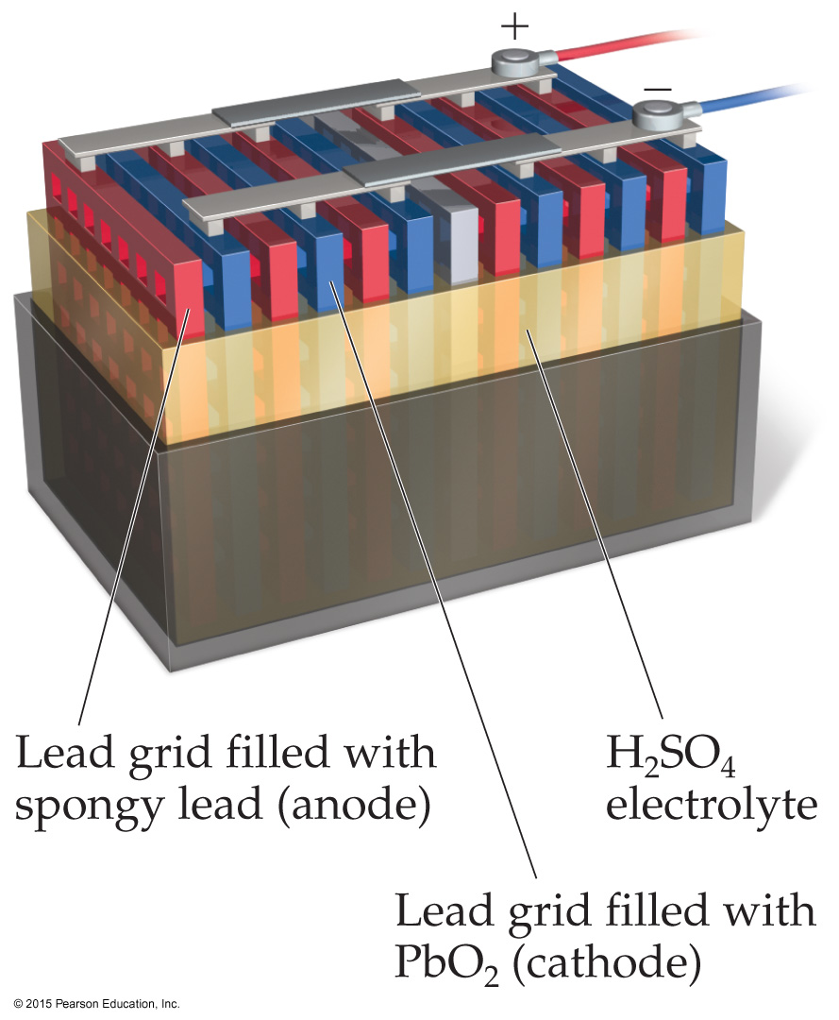
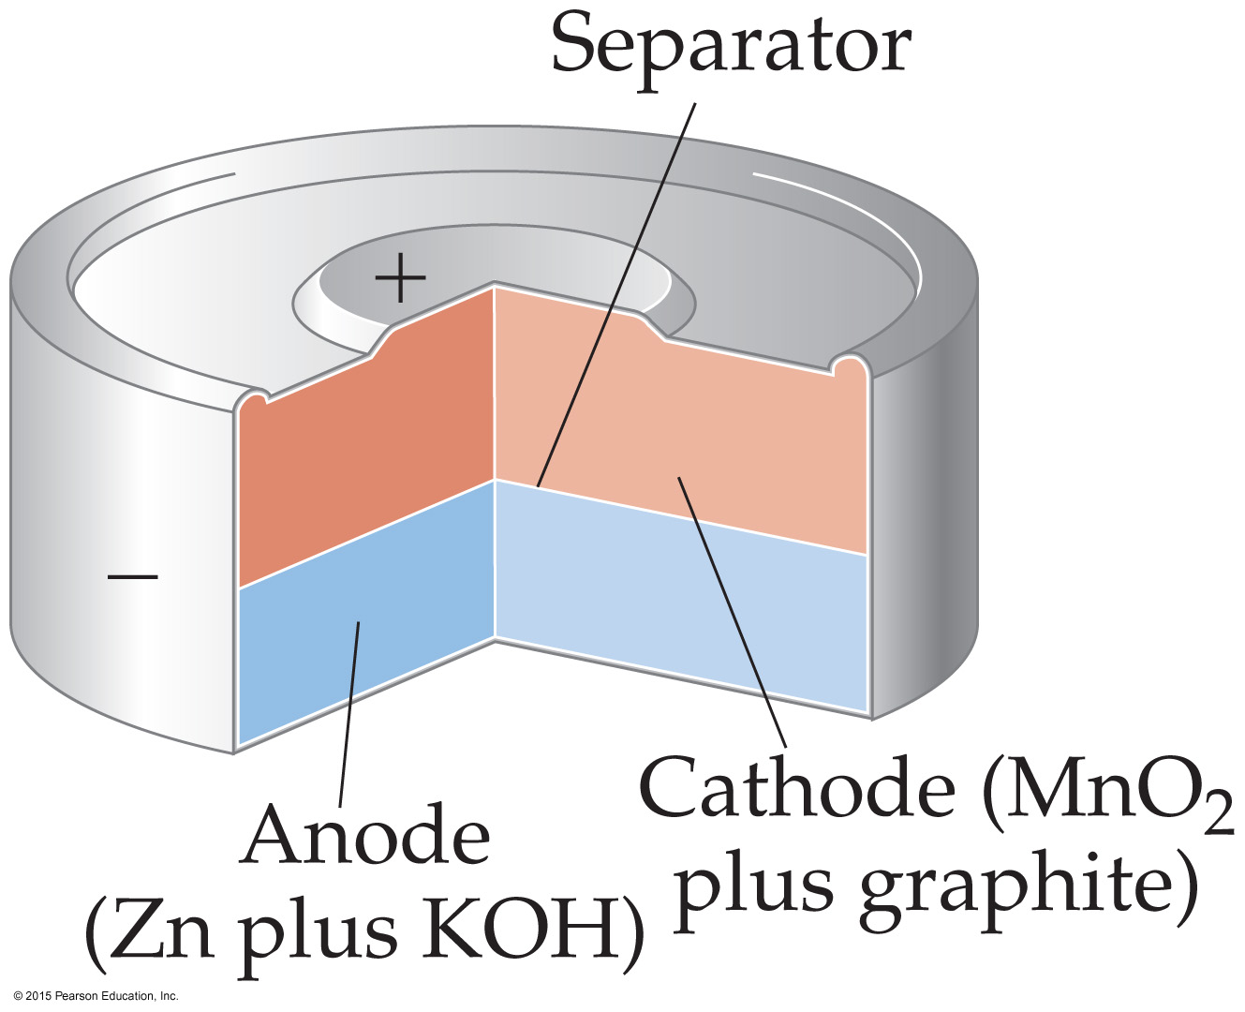
Some Batteries
Lead–Acid Battery
Alkaline Battery

Slide 35
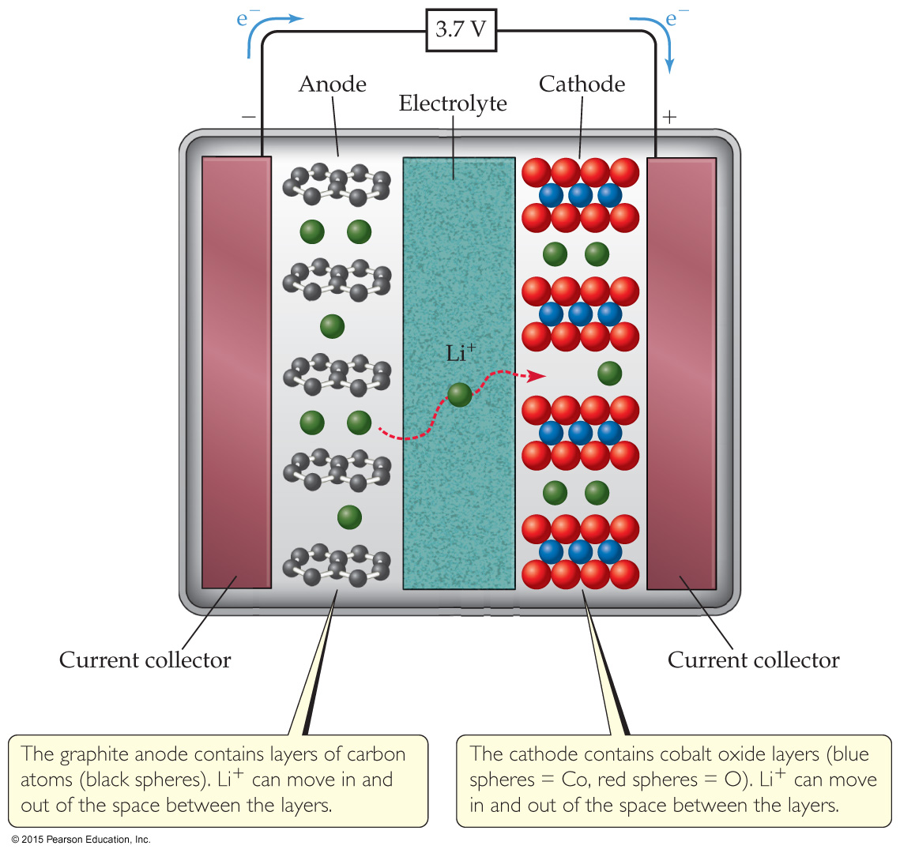
Lithium-Ion Battery

Slide 36
Fuel Cells
When a fuel is burned, the energy generated can be converted to electrical energy.
Usually, this conversion is only 40% efficient, with the remainder lost as heat.
The direct conversion of chemical to electrical energy is expected to be more efficient and is the basis for fuel cells.
Fuel cells are NOT batteries; the source of energy must be continuously provided.

Slide 37
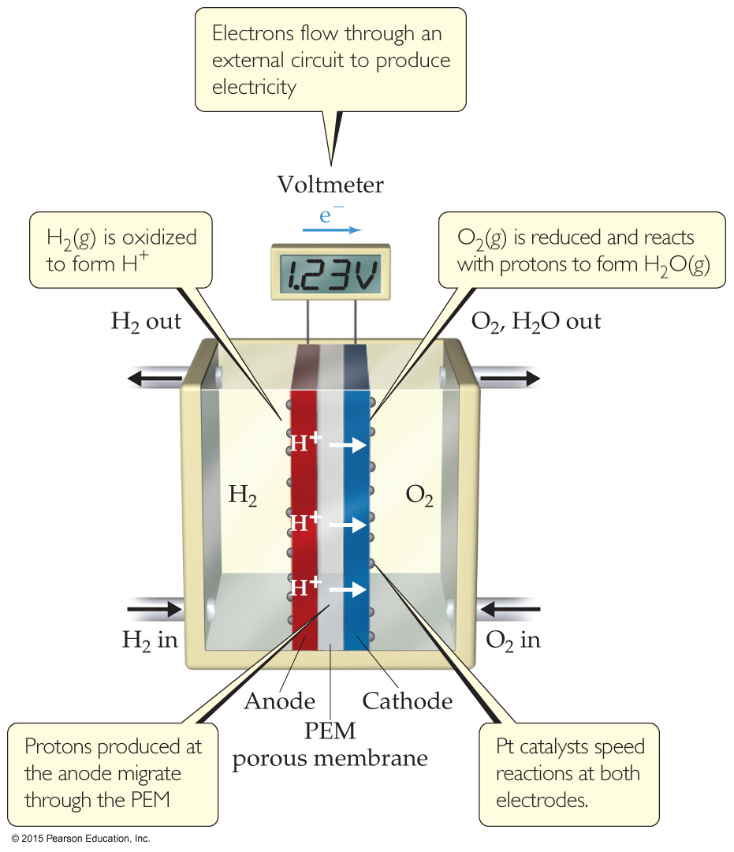
Hydrogen Fuel Cells
In this cell, hydrogen and oxygen form water.
The cells are twice as efficient as combustion.
The cells use hydrogen gas as the fuel and oxygen from the air.
PEM: proton exchange membrane

Slide 38
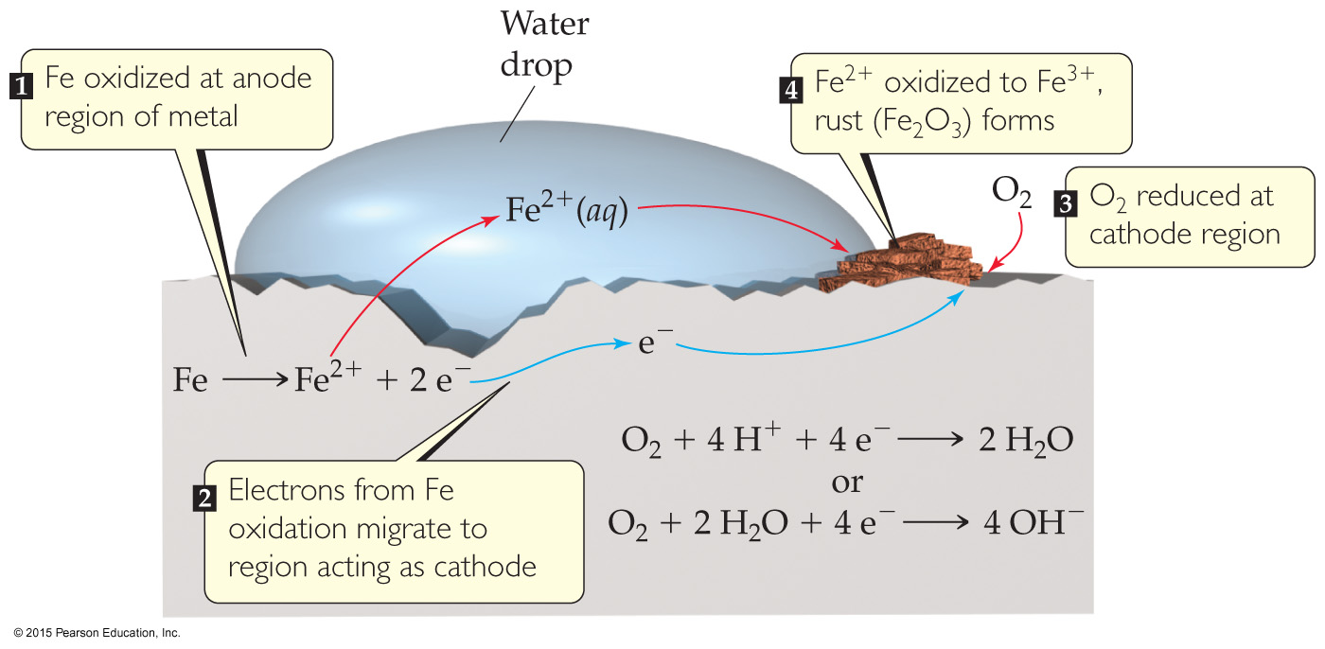
Corrosion
Corrosion is oxidation.
Its common name is rusting.

Slide 39
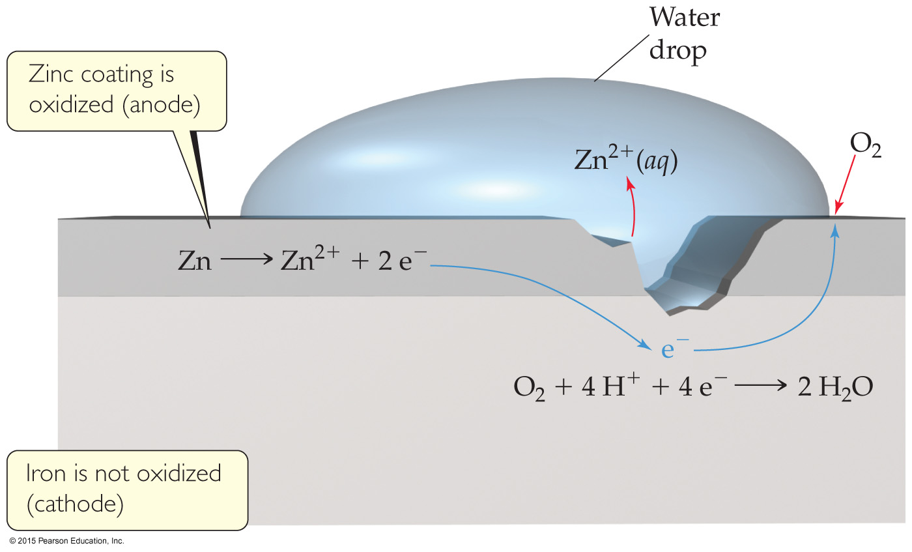
Preventing Corrosion
Corrosion is prevented by coating iron with a metal that is more readily oxidized.
Cathodic protection occurs when zinc is more easily oxidized, so that metal is sacrificed to keep the iron from rusting.

Slide 40
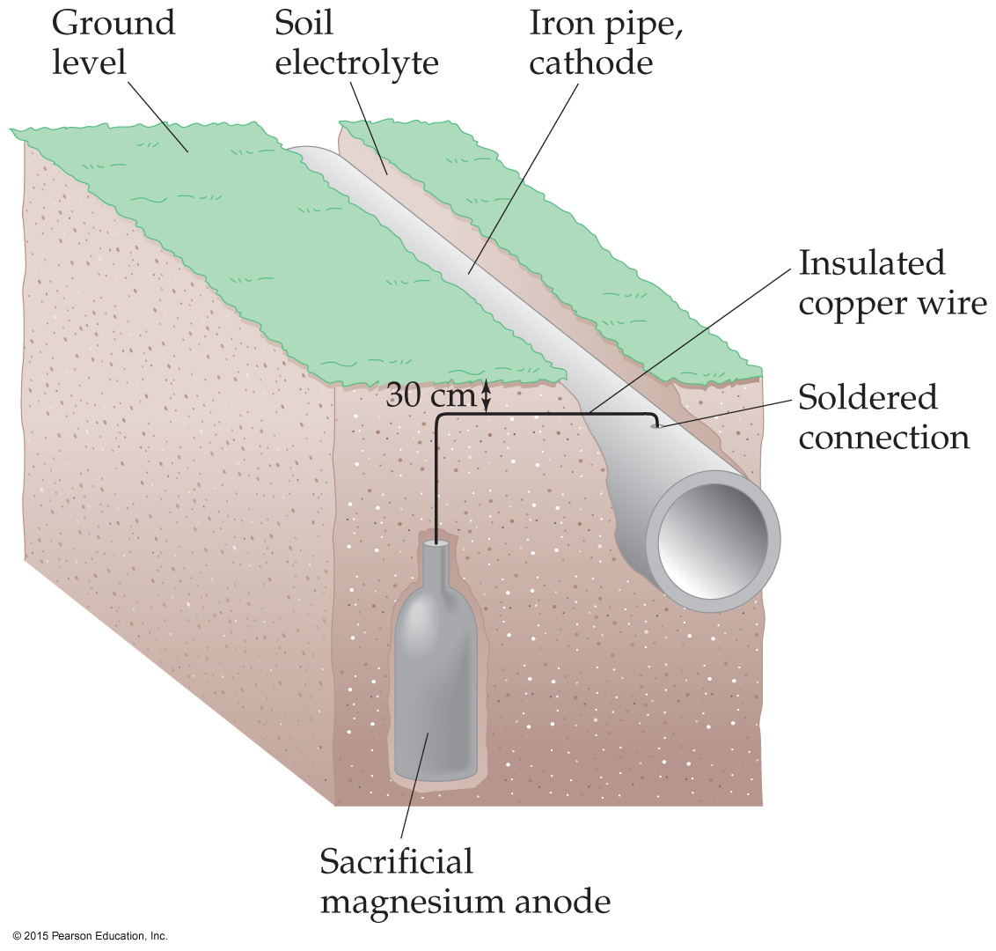
Preventing Corrosion
Another method to prevent corrosion is used for underground pipes.
A sacrificial anode is attached to the pipe. The anode is oxidized before the pipe.

Slide 41
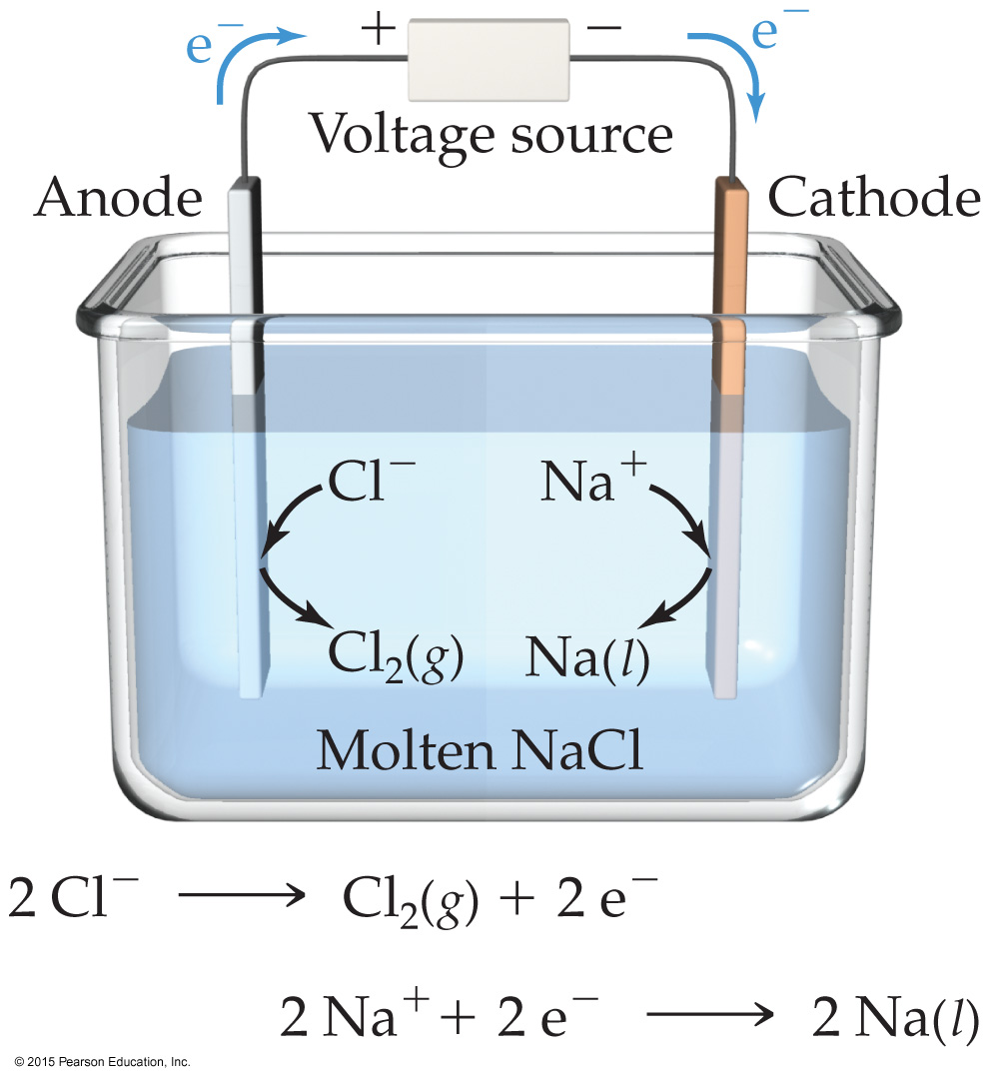
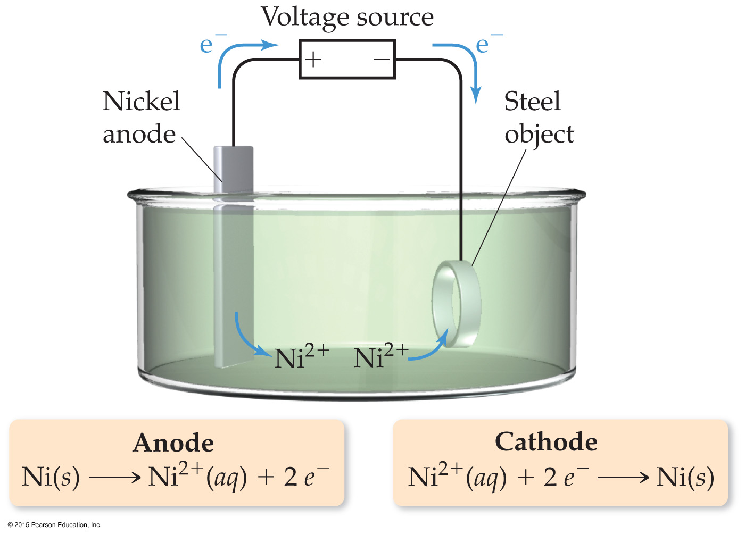
Electrolysis
Nonspontaneous reactions can occur in electrochemistry IF outside electricity is used to drive the reaction.
Use of electrical energy to create chemical reactions is called electrolysis.

Slide 42
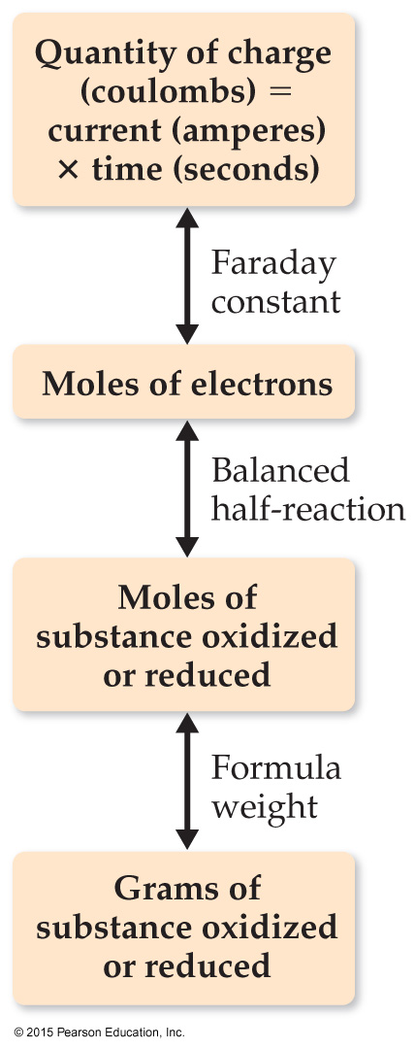
Electrolysis and “Stoichiometry”
1 coulomb = 1 ampere × 1 second
Q = It = nF
Q = charge (C)
I = current (A)
t = time (s)
n = moles of electrons that travel through the wire in the given time
F = Faraday’s constant
NOTE: n is different than that for the Nernst equation!

